Slide 1
DECEMBER FINANCIAL/ ENROLLMENT REPORT
Board Meeting December 15, 2023

Slide 2
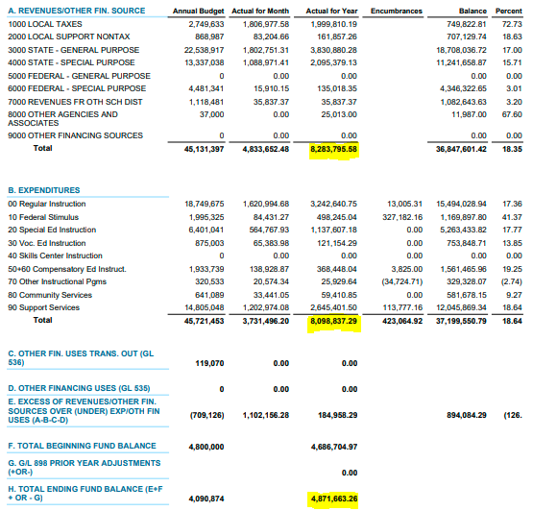
OCTOBER 2023 BUDGET STATUS REPORT – GENERAL FUND

Slide 3
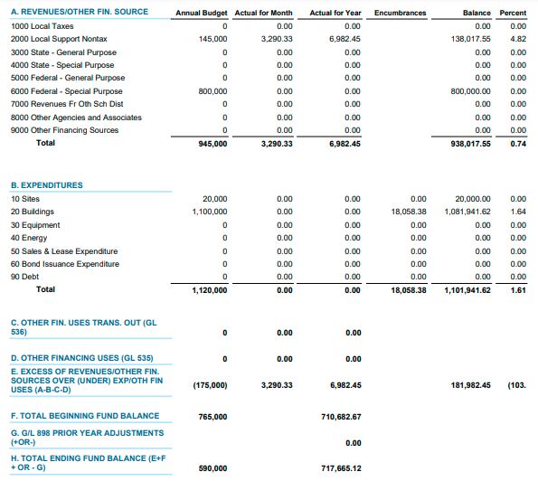
OCTOBER 2023 BUDGET STATUS REPORT – CAPITAL PROJECTS FUND

Slide 4
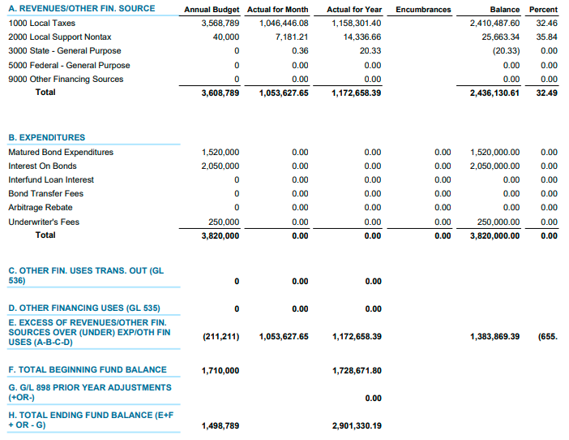
OCTOBER 2023 BUDGET STATUS REPORT – DEBT SERVICE FUND

Slide 5
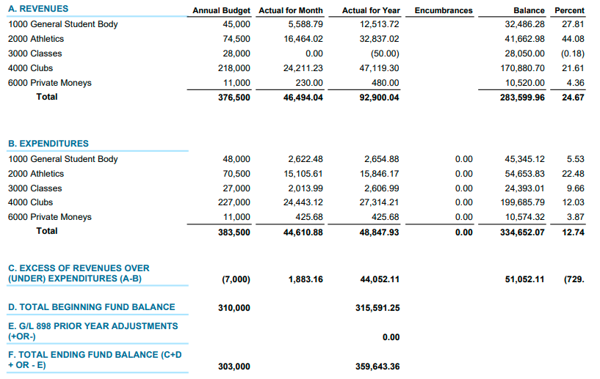
OCTOBER 2023 BUDGET STATUS REPORT – ASB FUND

Slide 6
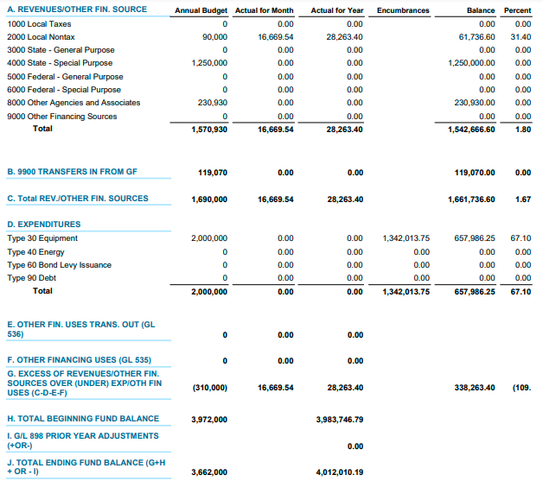
OCTOBER 2023 BUDGET STATUS REPORT – TRANSPORTATION VEHICLE FUND

Slide 7
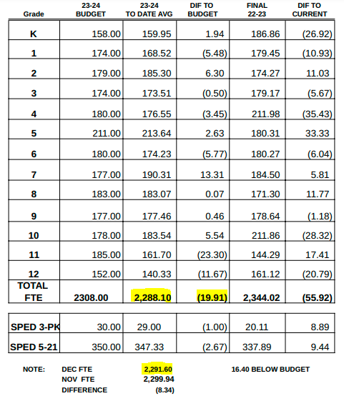
FTE ENROLLMENT – DECEMBER 2023

Slide 8
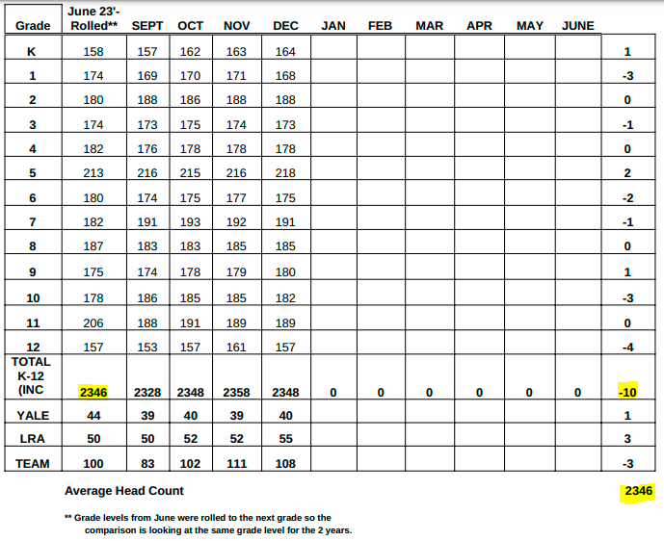
HEADCOUNT ENROLLMENT – DECEMBER 2023

